Slide 1
AI Camera Using ESP32-CAM

Slide 2
Introduction
In this project, we will create an AI camera using ESP32-CAM module. This module is connected with wi-fi. We can take the picture of the product and know all details about the product. We also used 3.5 TFT display to see the details. We will also implement OTA updates to ensure the camera's firmware stays up-to-date.

Slide 3
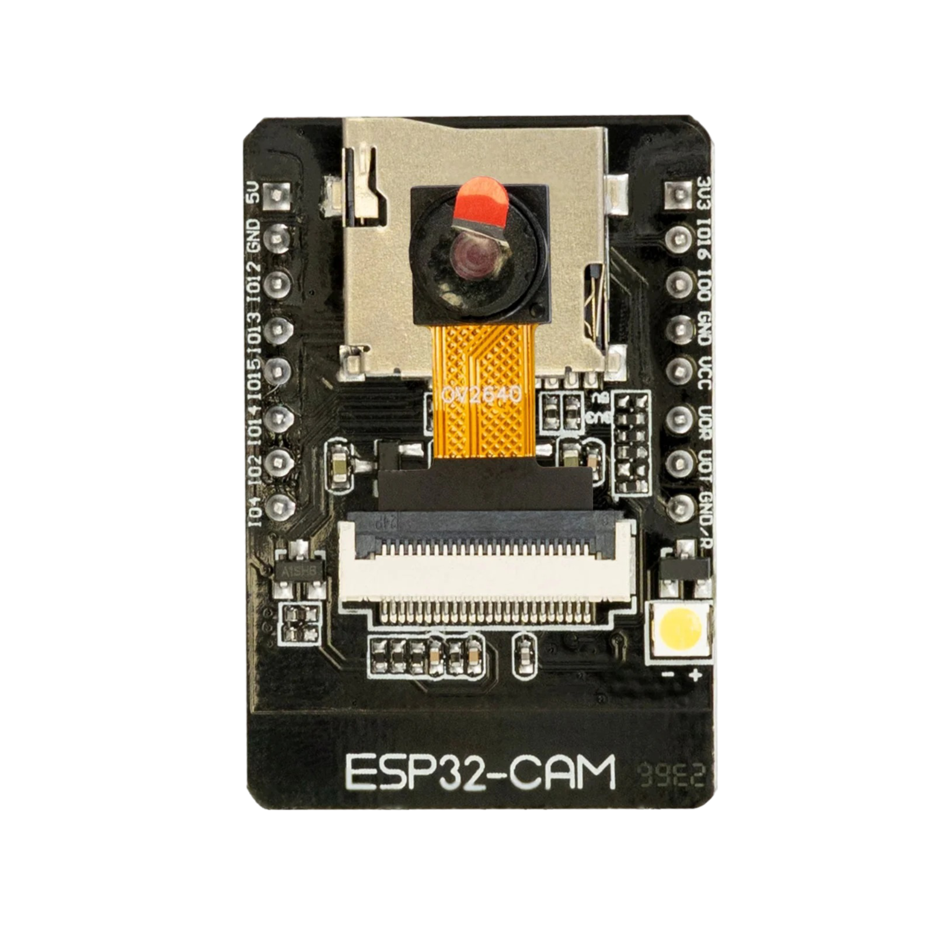
ESP32-CAM
The esp32-cam is a versatile module that integrates and esp32 –cam,And Wi-fi connectivity. It enables real time video streaming and image Capture.

Slide 4
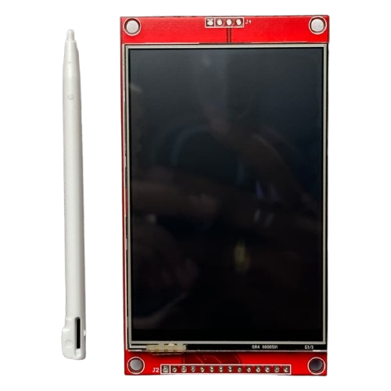
3.5 TFT DISPLAY
This ILI9488 Driver base 3.5 TFT(Thin-Film Transistor) Display with a resolution of 480*320.
Display viewing angle usually around 60 to 80 degree horizontal and vertical.
The esp32-cam live video streaming in Display

Slide 5
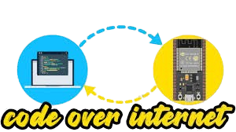
OTA Updates
OTA updates enable you to remotely update the firmware of your ESP32 Cam module, ensuring it stays up-to-date and secure
Customizable update and process.

Slide 6
GPT-4O API
Here we use GPT-4.o in personal use so we have to create an account and have to pay 500rs to use this and the website is platform.open AI.com
After create an account we can provide the code through this and ask the question about the image.

Slide 7
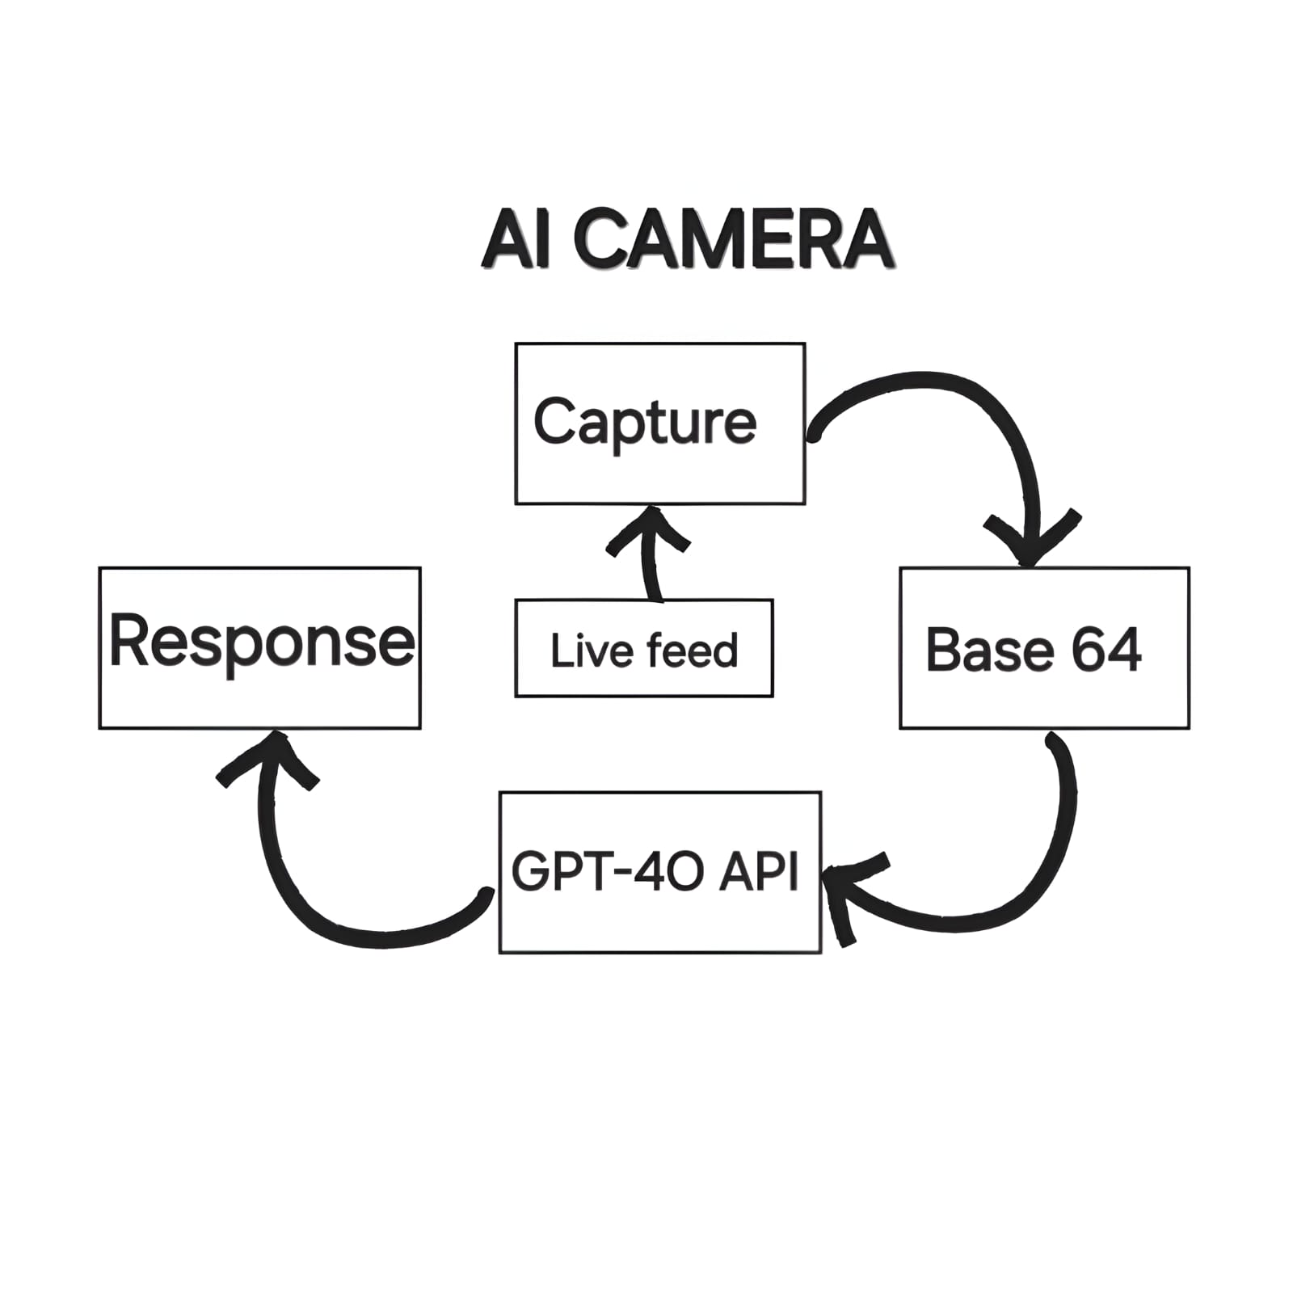
WORKING PRINCIPLE
Live Feed: Data from "Capture" flows here, where a live video feed is managed.
Capture: This is the starting point of the process.
Base64: The live feed data is converted to Base64 encoding at this step.
GPT-4.0 API: The encoded data is processed through the GPT-4.0 API, which likely analyzes or generates responses based on the input.
Response: A response is generated and the flow loops back to "Capture," creating a continuous feedback process.

Slide 8
BENEFITS
Light weight -the device is light weight so we can carry it any where
Small and Compact Design ESP32-CAM modules are small and lightweight, making them easy to integrate into embedded systems and wearable devices.
Wireless Connectivity Wi-Fi & Bluetooth support enables real-time image/video streaming and remote monitoring.

Slide 9
USE CASES
In agriculture system we can use this device to find the details about the plant.
The system finds applications in tourist proposal and rural areas to find the details about the object/product so that they can understand the product properly.
We use an Al tool chatGPT to find the results.

Slide 10
CHALLENGES AND SOLUTIONS
When we work on this project the display cannot work properly and cannot show the captured picture and display is very small so we are added a big 3.5”TFT display in it.
After we install the display the touch on the display not working so we calibrate touch value on code.

Slide 11
FUTURE DEVELOPMENTS
Voice command: In future we can add voice command to take the picture after taking the picture and take the action on the picture through voice command.
Facial Recognition: Implement facial recognition capabilities to identify the person.

Slide 12
conclusion
In this project, we created a AI camera using ESP32 camera module and this project we are able to click the picture of the object and know all the details about it.

Slide 13
Thank you

